Slide 1

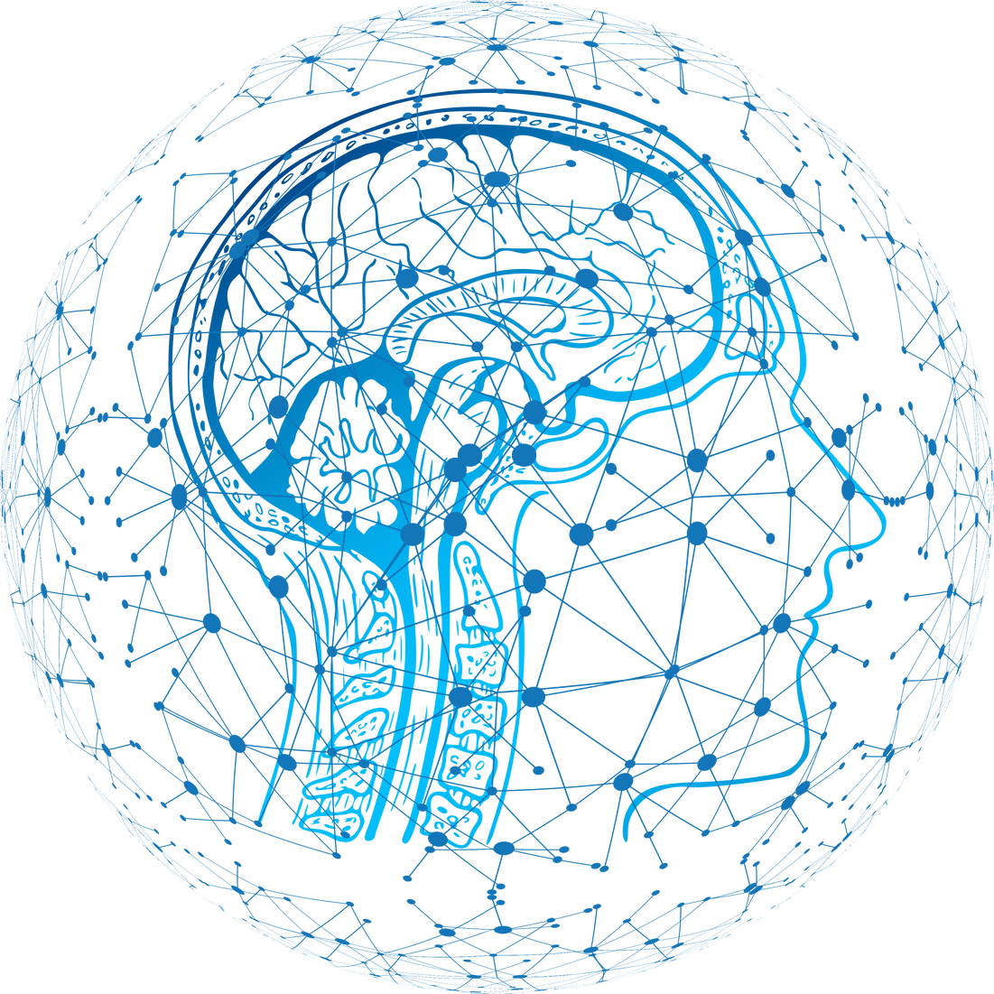
CAPSTONE PROJECT
ASL Character Recognition
Using Deep Learning
Durgesh Singh Gour
Roll No : 25DLS157
IIIT Una , IT
WEBSITE FOR LIVE DEMO(Click)
01

Slide 2

INTRODUCTION
American Sign Language (ASL) is a visual language used by the deaf and hard-of-hearing community.
Automatic ASL recognition helps bridge the communication gap.
This project uses deep learning to recognize ASL alphabets from images.
This project uses CNN and TensorFlow to translate ASL and to improve communication between hearing and deaf individuals.
02

Slide 3
Problem & Motivation
Communication barriers affect over 70 million deaf individuals worldwide.
Lack of accessible communication tools limits social and educational opportunities.
Goal: Develop an automated ASL recognition system with >95% accuracy to bridge this gap.
Utilize modern AI frameworks for robust and scalable solutions.
01
02
03

Slide 4
Project Objectives
Develop a robust, real-time ASL recognition system to bridge communication gaps.
Target >95% accuracy for practical usability in diverse environments.
Ensure accessibility through a user-friendly interface and open-source deployment.
Leverage state-of-the-art deep learning and computer vision techniques.
04

Slide 5
Technology Stack Overview
Deep Learning Frameworks: TensorFlow, Keras for model development and training.
Transfer Learning Models: VGG16, ResNet50, MobileNetV2, InceptionV3, EfficientNet—chosen for proven performance in image classification tasks.
Hand Detection: MediaPipe for precise, real-time hand landmark extraction.
Deployment: Hugging Face Spaces for public, cloud-based access.
Supporting Libraries: OpenCV for image processing, scikit-learn for evaluation metrics.
05

Slide 6
Dataset Collection & Preprocessing
Dataset Name | Number of Classes | Number of Samples | Image Size | Data Source
ASL Alphabet | 29 | 87,000 | 200x200 | Custom collection
MNIST-ASL | 24 | 22,200 | 28x28 | Kaggle
ASL Finger Spelling | 24 | 67,000 | 100x100 | Custom collection
Synthetic ASL Alphabet | 27 | 27,000 | 512x512 | Kaggle
ASL Sign Language Alphabet Pictures | 26 | 8442 | 1920x1920 | Kaggle
06

Slide 7
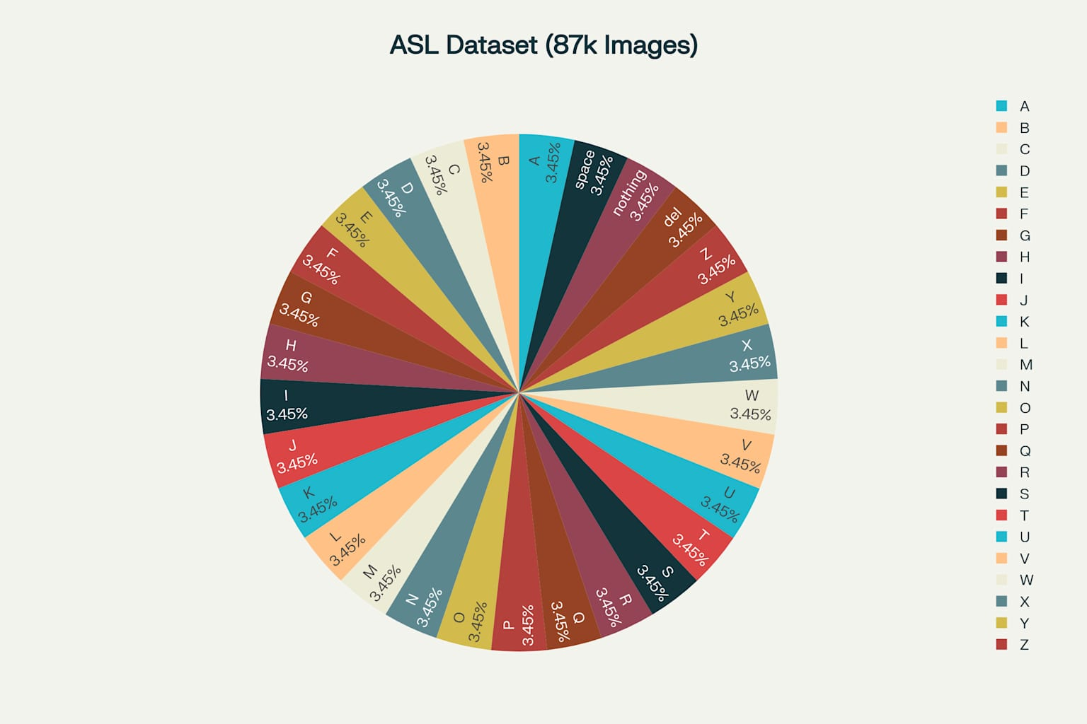
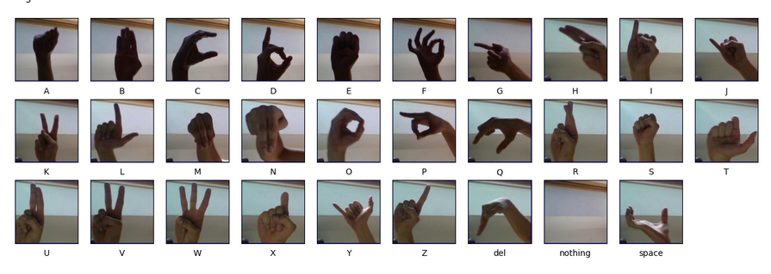
Dataset Used
Dataset: ASL Alphabet Dataset asl-alphabet from Kaggle, containing 29 classes And 87,000 samples (A-Z, plus 'delete', 'nothing', 'space’).
Resize images to 224x224 pixels for compatibility with pre-trained models.
Normalize pixel values to for stable training.
One-hot encode labels for multi-class classification.
Split data: 80% training, 20% validation/test
07

Slide 8
Data Augmentation Strategies
Purpose: Increase dataset diversity, reduce overfitting, and improve generalization.
Techniques Used:
Random rotation (up to 30-40°)
Width/height shift (up to 30-40%)
Shear, zoom, and horizontal flip
Brightness adjustment (0.7–1.3)
Real-time augmentation with Keras’ ImageDataGenerator
Impact: Makes the model robust to variations in hand position, lighting, and background
08

Slide 9
VGG16 Model Architecture
Transfer Learning: Started with pre-trained VGG16 (ImageNet weights)
Custom Head:
Flatten
Dense(256, relu)
Dropout(0.5)
Dense(29, softmax)
Fine-Tuning:
First, froze all convolutional layers and trained only the custom head
Then, fine-tuned twice: unfreezing last 4–8 VGG layers in two stages for deeper adaptation to ASL data
09

Slide 10
MediaPipe Integration & Training Methodology
Used for real-time hand landmark detection
Improved hand region localization and reduced background noise
Enhanced input quality for the classifier
Augmentation: Real-time, on-the-fly using ImageDataGenerator
Callbacks: ModelCheckpoint (save every epoch), EarlyStopping, ReduceLROnPlateau
Batch Size: 34(First),64(Second)
Epochs: 10–15
10

Slide 11
Fine-Tuning Strategy &
Performance Optimization
First Fine-Tune: Unfroze last 4 layers, trained with low learning rate (1e-5)
Second Fine-Tune: Unfroze last 8 layers, further trained for deeper feature adaptation
Result: Each stage improved validation accuracy, confirming the value of progressive fine-tuning
Hyperparameter tuning for learning rate, batch size, and augmentation range
Used ReduceLROnPlateau to adjust learning rate dynamically
Achieved stable convergence and minimized overfitting
11

Slide 12
Real-Time Application Pipeline
Live webcam input processed via MediaPipe
Preprocessed and fed to fine-tuned VGG16 model
Prediction displayed instantly in web app UI
12

Slide 13
Deployment
Model exported as .keras and deployed on Hugging Face Spaces
Streamlit app for user-friendly interface
Huggingface for checkpoint backup and versioning
WEBSITE
13

Slide 14
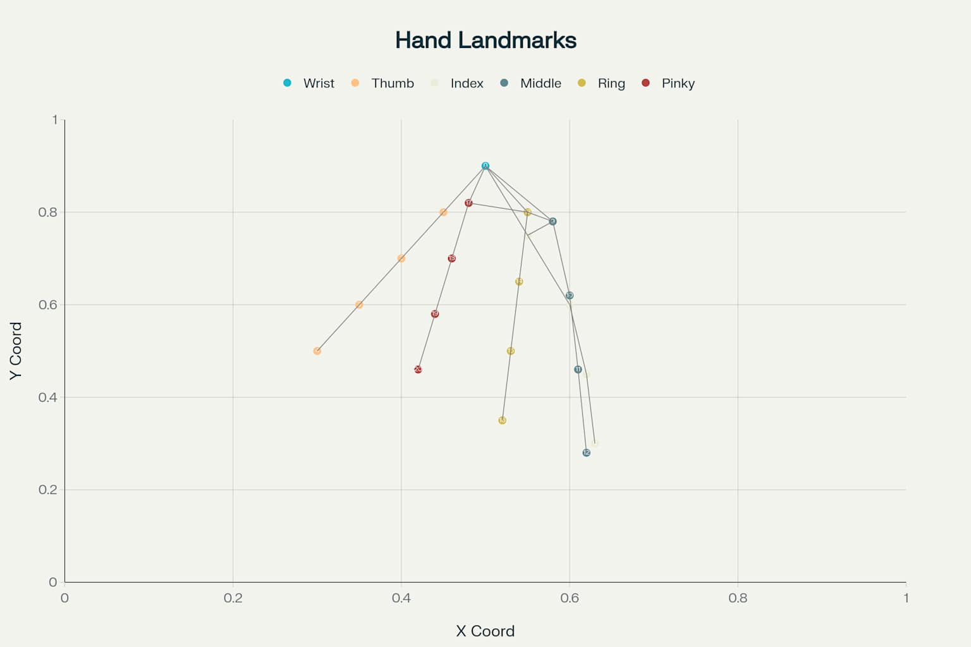
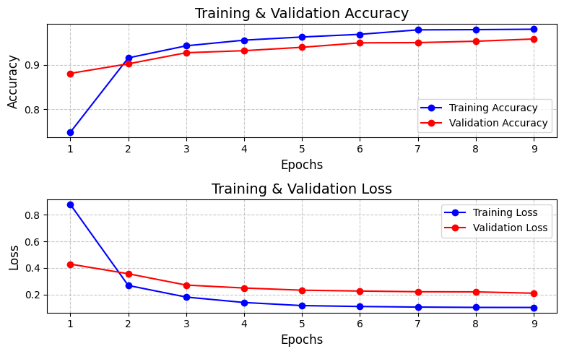
Model Performance
Final Validation Accuracy: 96.7% after two rounds of VGG16 fine-tuning
Training Curve: Accuracy improved steadily, loss decreased and stabilized (see plot)
Confusion Matrix: High precision/recall across most classes; minor confusion in visually similar signs
14

Slide 15
Challenges Faced
Data Imbalance: Some ASL signs have many more images than others, causing model bias and lower accuracy for rare signs.
Real-World Variability: Changes in lighting, background, hand size, and skin tone reduce recognition accuracy outside controlled conditions.
Similar Gestures: Certain ASL letters look visually similar (e.g., M/N, D/E), leading to frequent misclassifications.
Overfitting Risk: Model may perform well on training data but fail on new users or unseen environments.
Deployment Constraints: Achieving real-time performance with high accuracy on standard hardware is challenging.
13

Slide 16
Ethical & Privacy Considerations
No webcam data stored or transmitted
User consent required for camera access
Open-source code for transparency
13

Slide 17
CONCLUSION
In conclusion, our study successfully implemented a CNN and TensorFlow model for ASL alphabet recognition, achieving high accuracy rates.
However, certain letters posed challenges, highlighting the need for refining the model architecture and dataset selection.
Moving forward, incorporating hand landmark data could enhance the model's precision and resilience by providing detailed hand positioning information.
Further improvements can be made by refining the model's architecture and expanding the dataset. We are just setting the foundation for advancements in ASL recognition technology, promoting accessibility and efficacy in real-world scenarios, such as education and communication for the deaf and hard of hearing.
A video walkthrough of project workflow and a live demo: (LINK)
15

Slide 18
Contact Information
Email: dsgaur1125@gmail.com
Spaces:spaces/DurgeshRajput11/
GitHub: github.com/DurgeshRajput11
LinkedIn: linkedin.com
Project Repository: GitHub
15

Slide 19
THANKS FOR YOUR TIME
16

